Slide 1
Power
needs
control
Mi mislimo na vašu sigurnost, tako da vi ne morate
Company
presentation 2019

Slide 2
Kako izgleda sigurnost?
Notes:
We all need to feel safe – physically, emotionally, socially and professionally. We want safety for our children and family. We all need to feel safe:physically, emotionally, socially and professionally.
At ETI we are well aware of all aspects of safety. Our products and solutions ensure the physical safety of people and property. We constantly build our expertise to cater to your specific needs and projects. We feel it is our responsibility to provide the best professional service and act as a loyal and trustworthy partner.
At ETI we always think of safety – so you don’t have to.

Slide 3
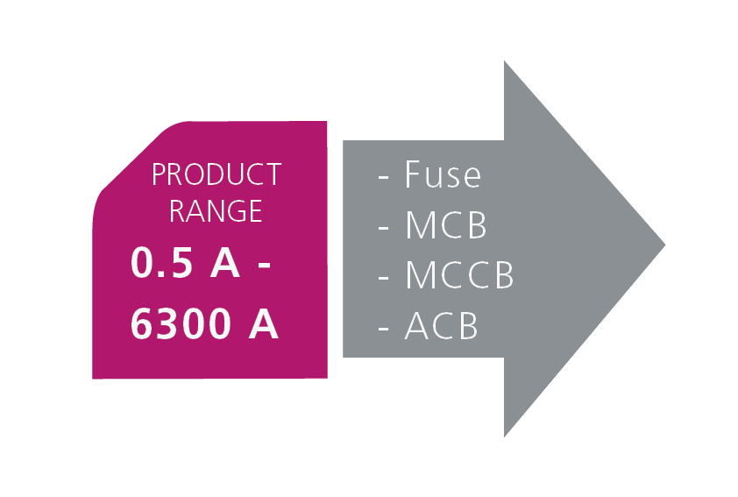
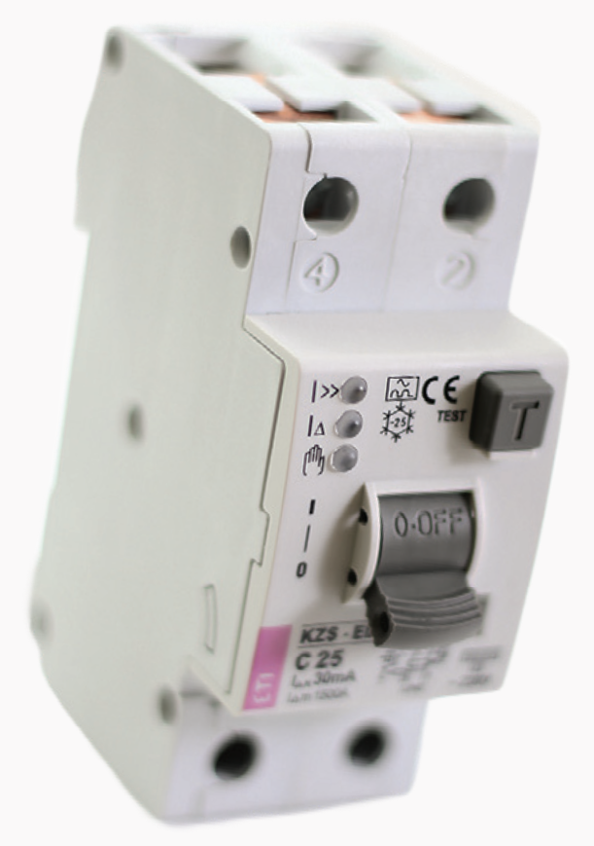
Naše učešće u pružanju sigurnosti
Među 5 najvećih svetskih proizvođača osigurača
Notes:
SAFETY is the basic function of all our products. We protect the property and people against overloads and faults in various electrical installations.
We are among top five of the largest producers of fuses in the world and leading producers of innovative switches and circuit breakers.
IEC BADGE: ETI’s employees as members and even presidents of IEC Committees are creating new standards for electrical products.

Slide 4
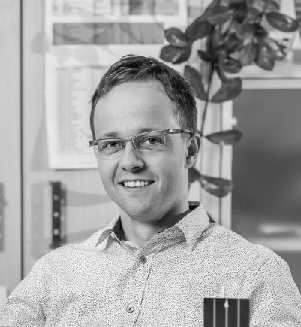
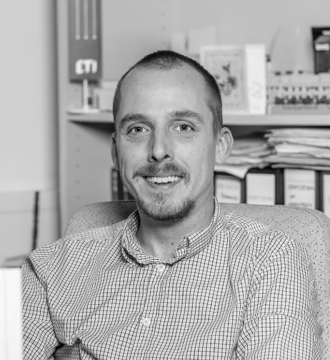
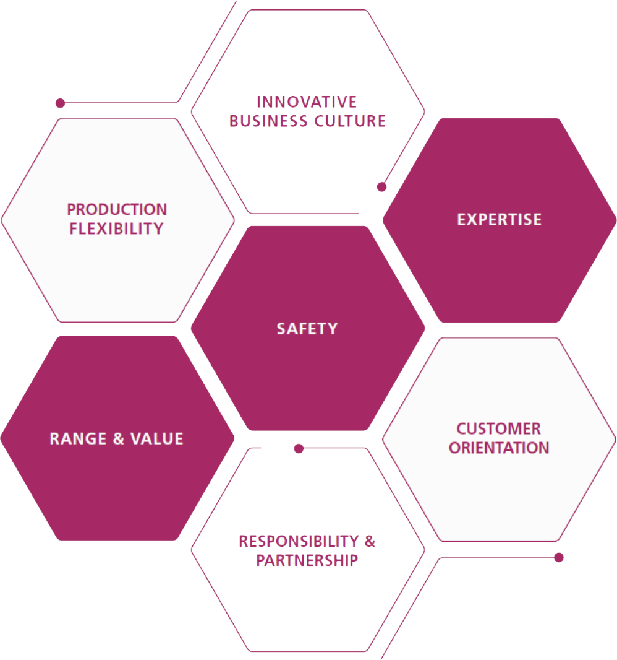
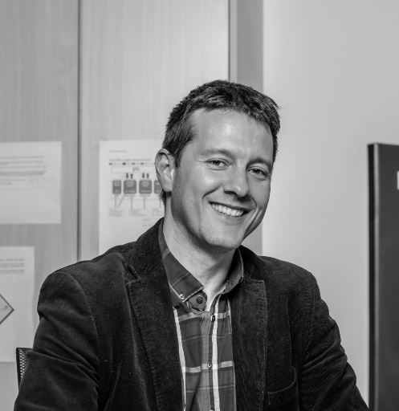
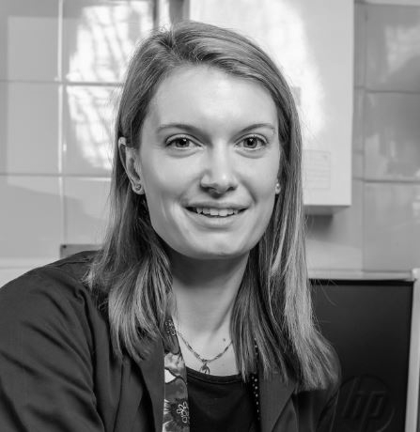
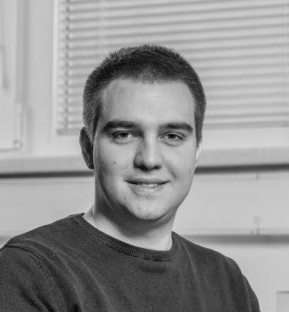
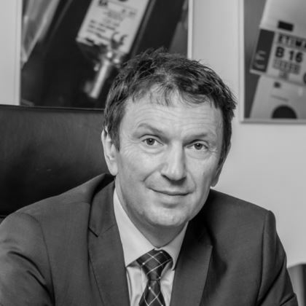
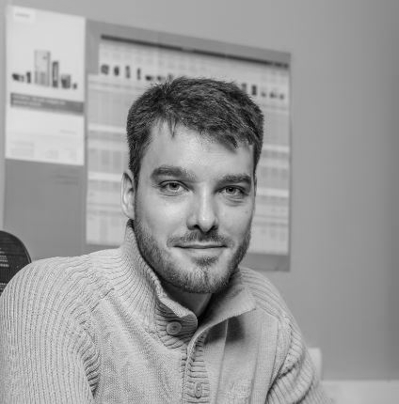
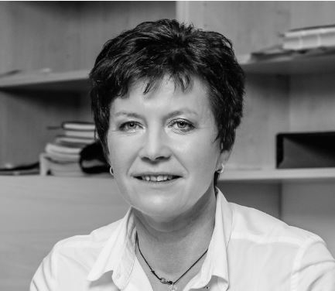
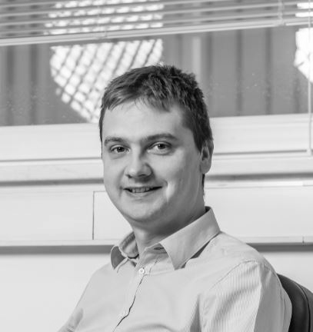
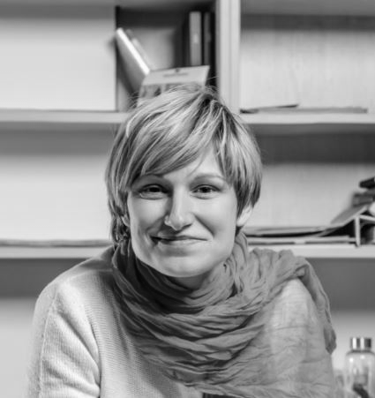
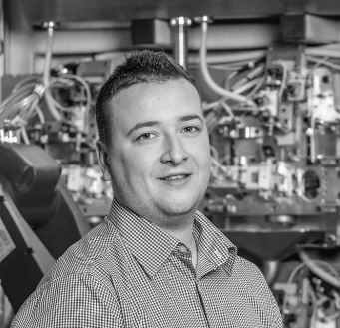
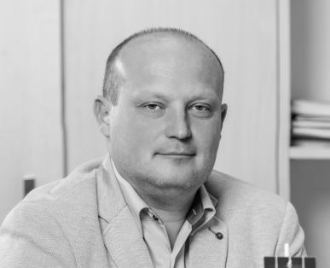
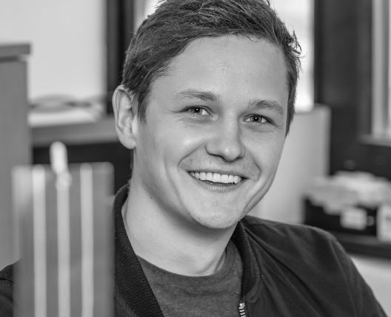
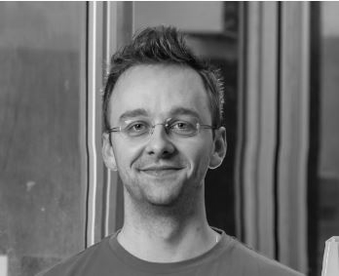
Notes:
Razlaga vsakega posameznega elementa

Slide 5
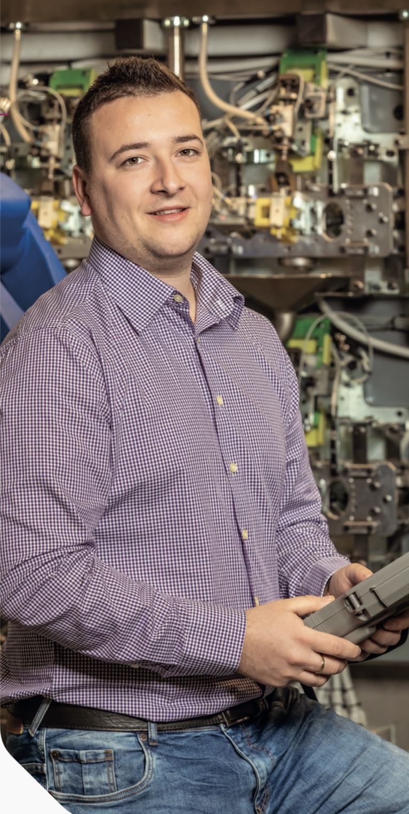
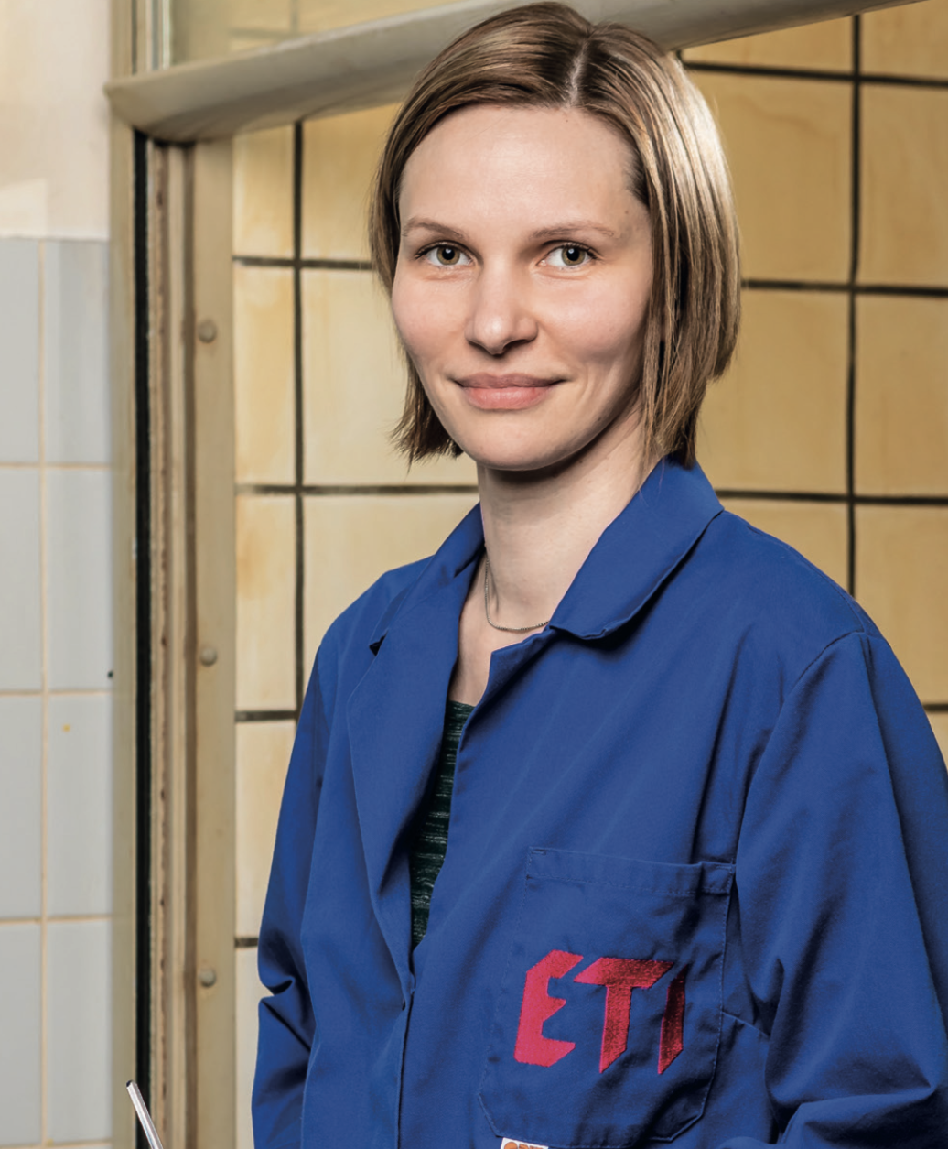
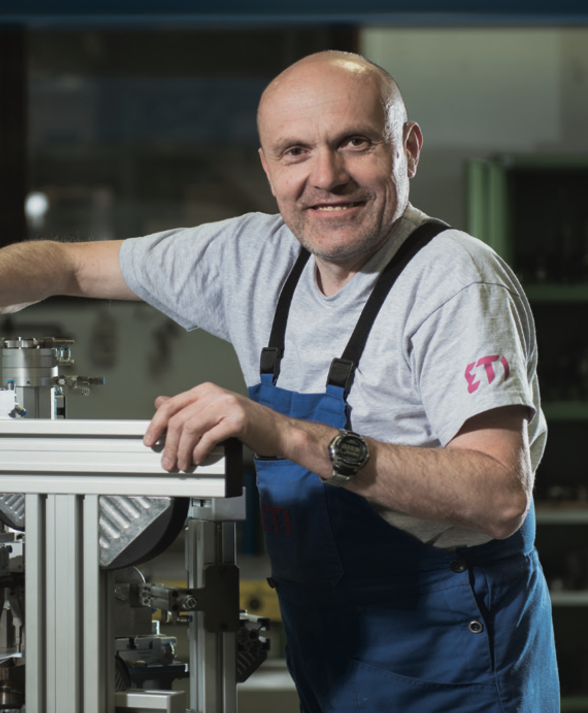
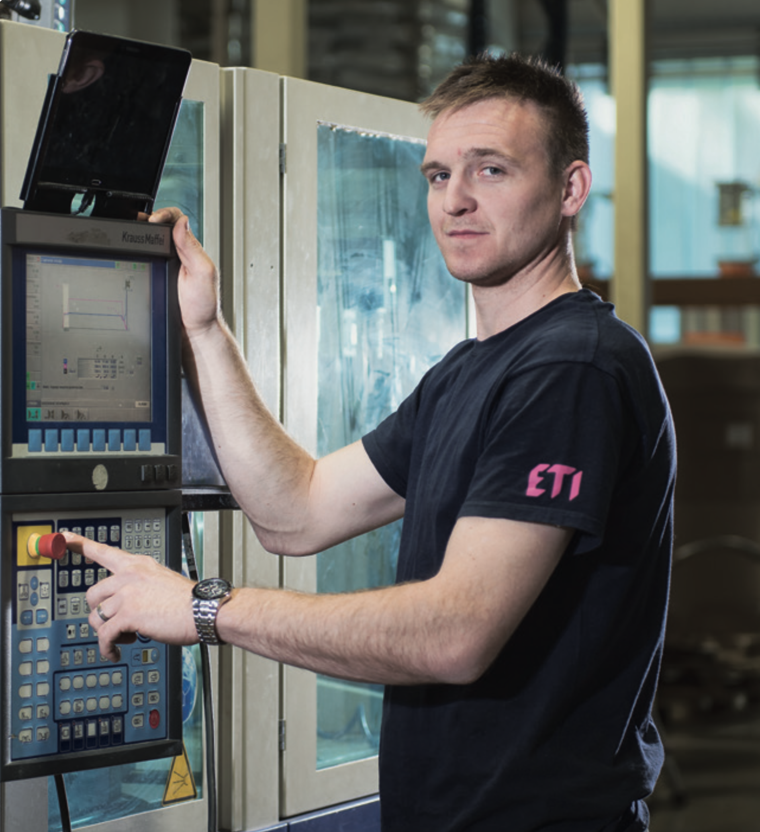
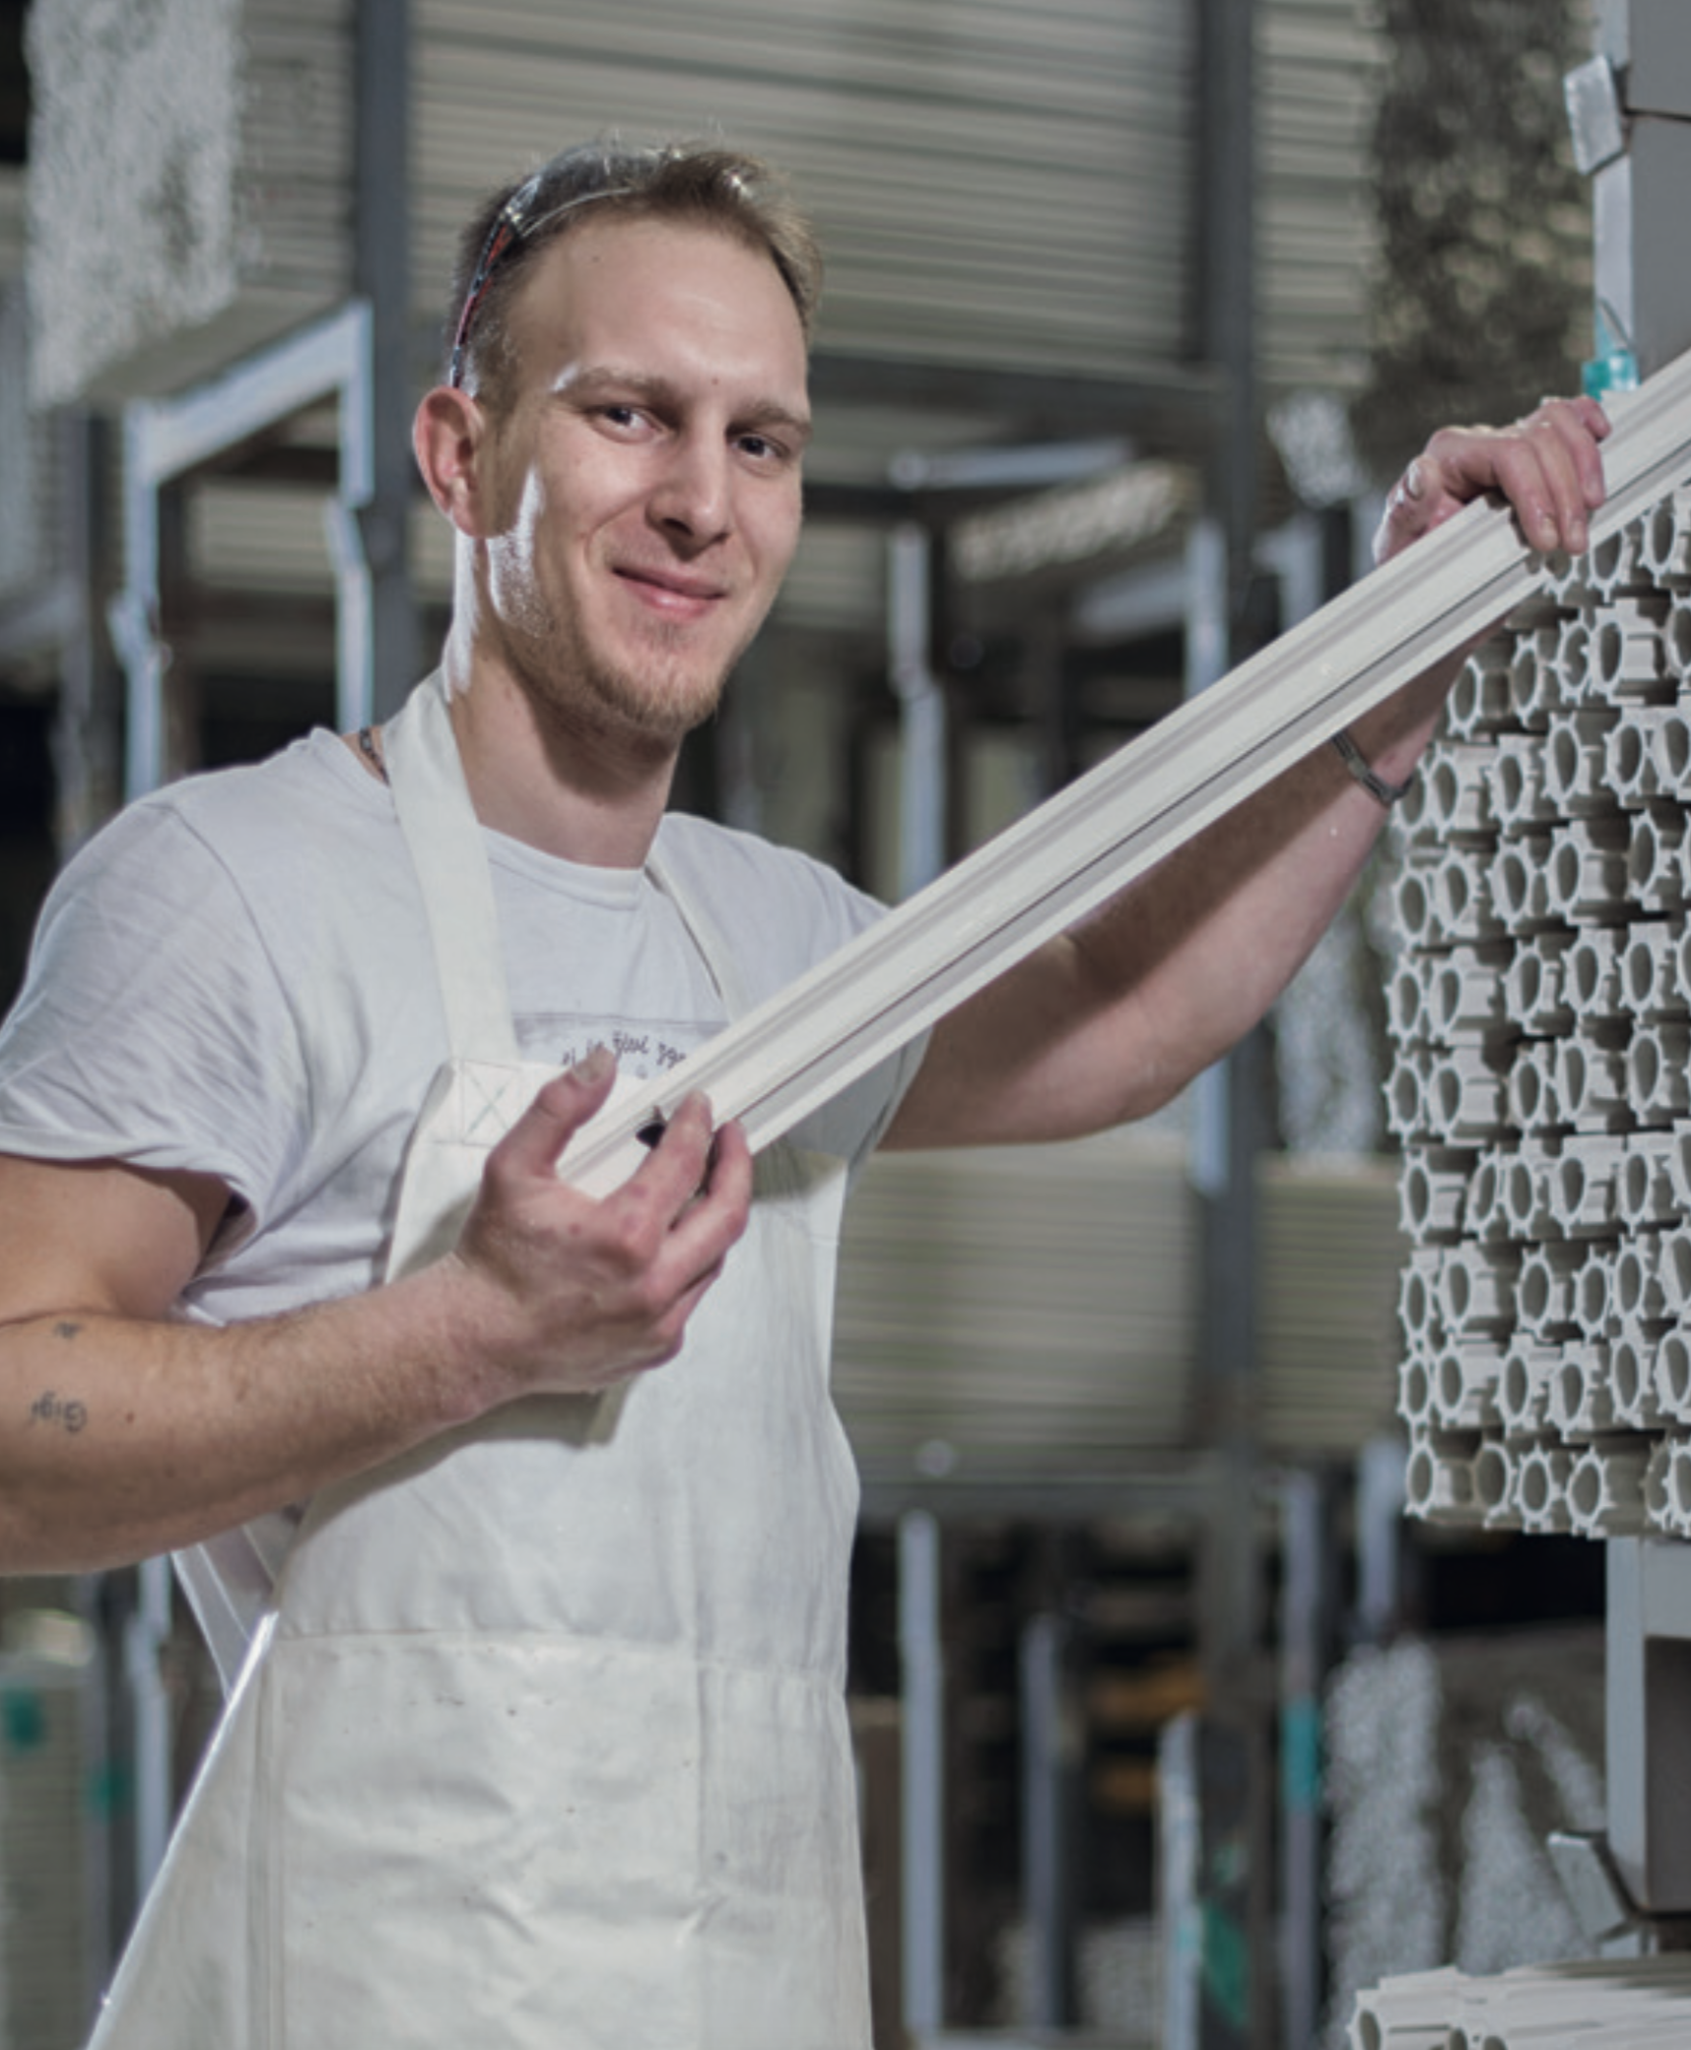
MI VERUJEMO
Da je bezbednost uvek na prvom mestu
122 naših zaposlenih svakodnevno kontroliše kvalitet naših proizvoda i proizvodnog procesa
15 testova se sprovede na svakom našem KZS-u pre nego što napusti proizvodnju
1900 naših zaposlenih, osigurava da naši partneri dobiju upravo ono rešenje koje im je potrebno
Notes:
At ETI we pay particular attention to our quality system. We have established a complex unity, supported by special procedures, resources, and tools for managing the overall quality of all our operations. Our quality system is designed to cover the technical and technological integrity of all manufacturing and business processes, and thus ensures the quality of those processes, our products, and services.

Slide 6
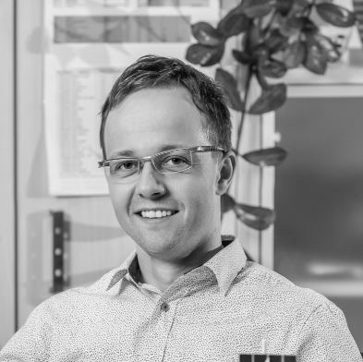
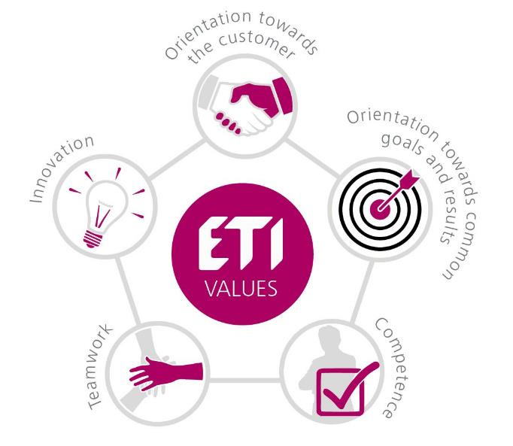
Bezbednost je u našim genima
Dokazujemo našu vrednost punih 70 godina.
Notes:
They are developed and produced by people who live by ETI values; safety is in our genes.

Slide 7
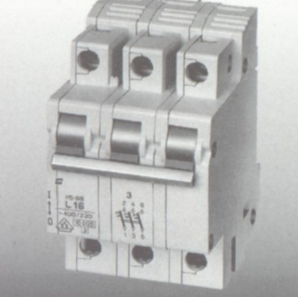
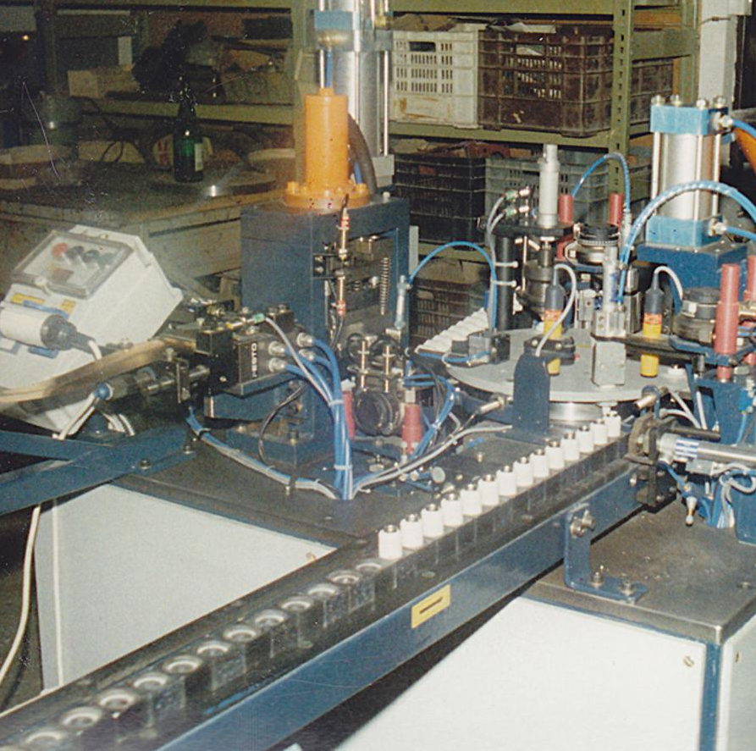
1977
ETI
70 godina tradicije
pravi prvi automatski prekidač
1997
Osnivanje prve ćerke firme
1954
Bergamnova lula
ETI-jev prvi elektro porcelanski proizvod
1960
1950
Fuse
1980
Osnivanje kompanije
ETI je jedan od prvih proizvođača topljivih osigurača
Automation
ETI razvija svoju prvu liniju za montažu

Slide 8
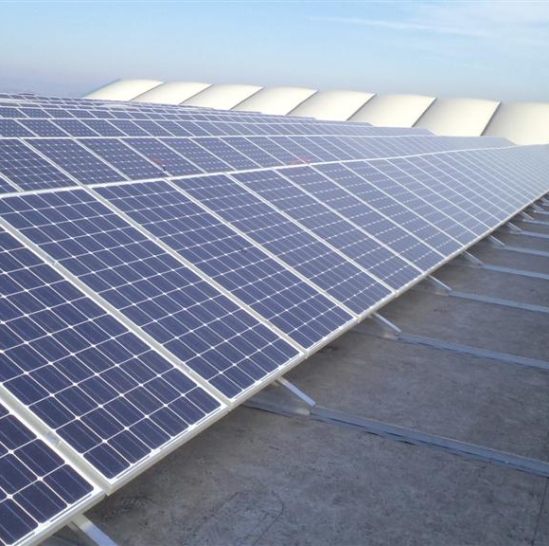
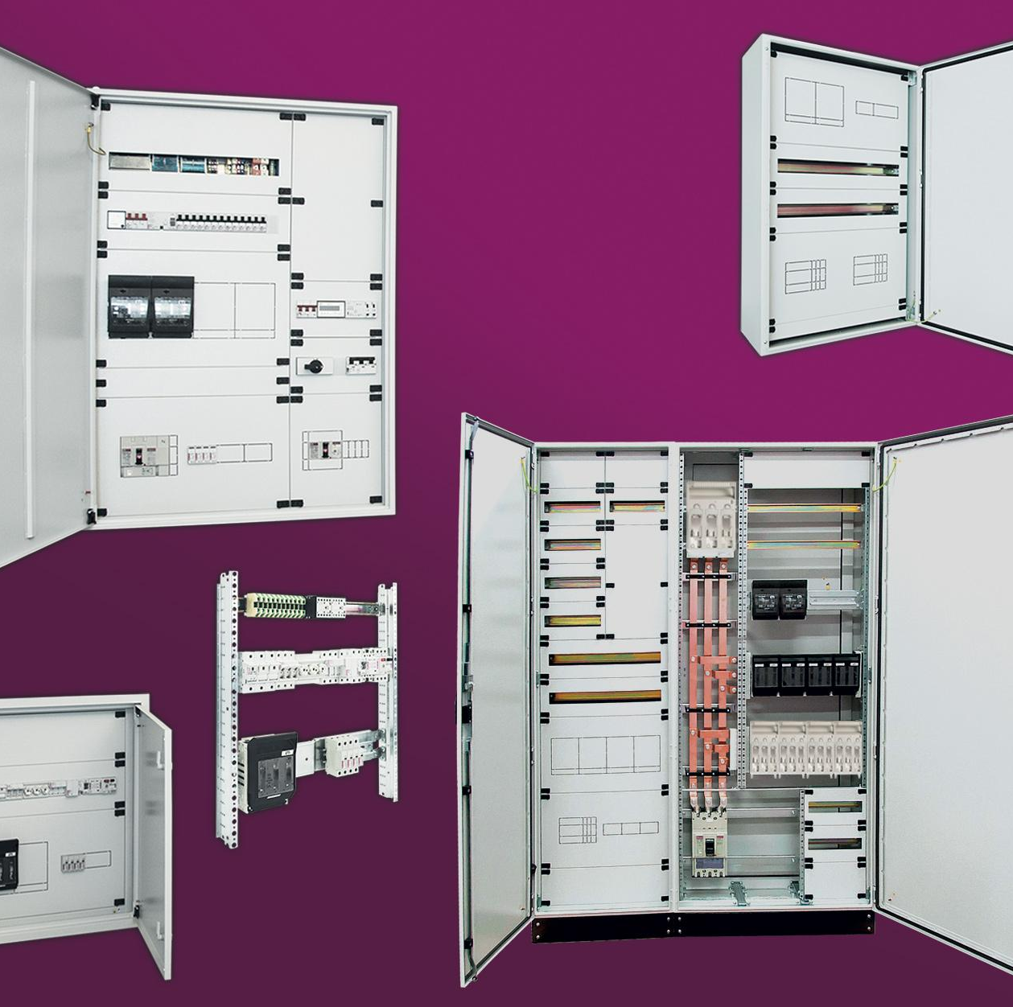
...i 70 godina iskustva
2008
Fotonaponski sistemi
2014
ETI je jedan od pionira u zaštiti fotonaponskih sistema
Utvrđivanje principa proizvodnje
2018
Opsežna reorganizacija proizvodnje za poboljšanje efikasnosti i produktivnosti
Opsežna automatizacija proizvodnih ciklusa
2017
2006
2012
Uvođenje šest sigma principa u svim poslovnim segmentima
ETI postaje sistem integrator
ETI Polam se pozicionirao kao proizvođač panela sa sopstvenim rešenjima

Slide 9
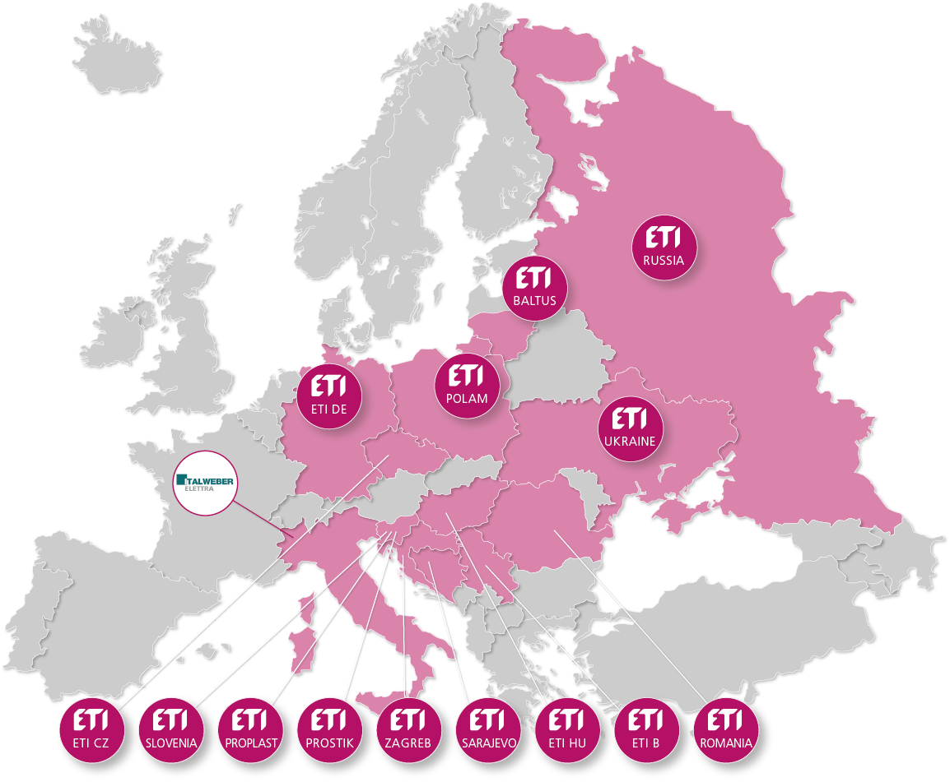
respected European brand

Slide 10
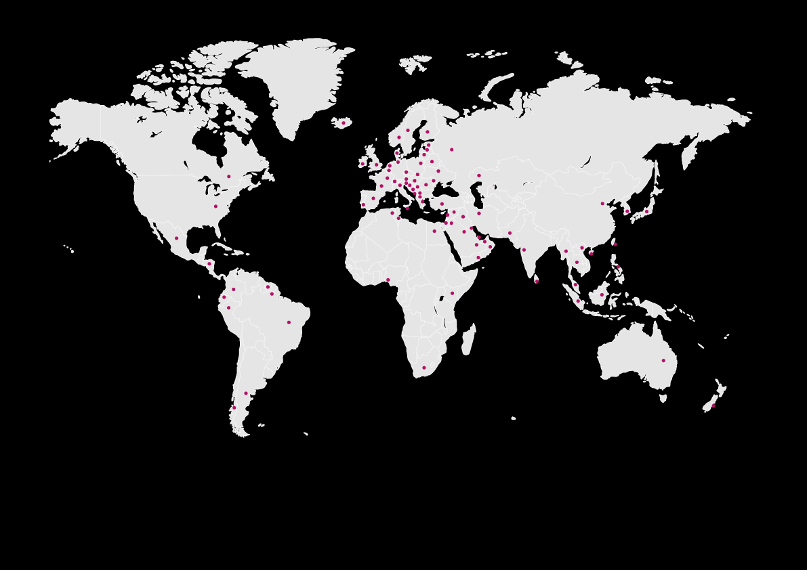
TAMO GDE SI TI, TAMO NALAZIŠ NAS
Preko 5000 kompanija veruje nama.
ETI ima proizvodne pogone u 9 zemalja, uključujući Sloveniju, Poljsku, Nemačku i BiH
27,154 m² skladišnog prostora: Slovenija, Nemačka, Rumunija, Poljska, BiH, …
ETI ćerke firme u 60 zemalja širom sveta
Notes:
ETI’s products are manufactured in nine countries across the world: Slovenia, Poland, Germany Bosnia and Herzegovina,....
ETI Group has established subsidiaries in 14 European countries.
ETI Group consists of more than 1,900 people, making sure to meet your needs and requests every day.
And so can over 5000 companies all over the world trust us with protecting the property and lives of their clients.

Slide 11
Naši partneri

Slide 12
Instaliranje
Testiranje
Proizvodnja
Razvoj
Dizajn
Integrisana usluga, tehničko savetovanje i podrška.
Stručnost
Notes:
We offer an integrated service, technical consulting and support.
We are not just a merchant; we are a manufacturer of products we offer. We have mastered the entire development, production, and testing process, as well as the design and installation of our products. Such comprehensive knowledge of our products and their functioning is what we build our partners’ trust on.
Our main guideline is quality assurance in all phases of the business process. Our solutions include engineering services, technical consultancy and electrical design for projects in the field of residential, commercial, industrial installations, as well as those for electric power distribution, photovoltaic and battery storage systems, and other renewable energy sources.
When it comes to finding
the appropriate solution, you will always find us at your side.

Slide 13
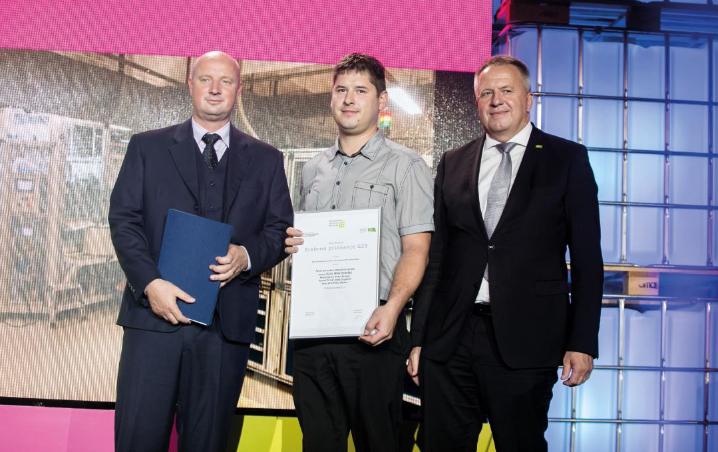
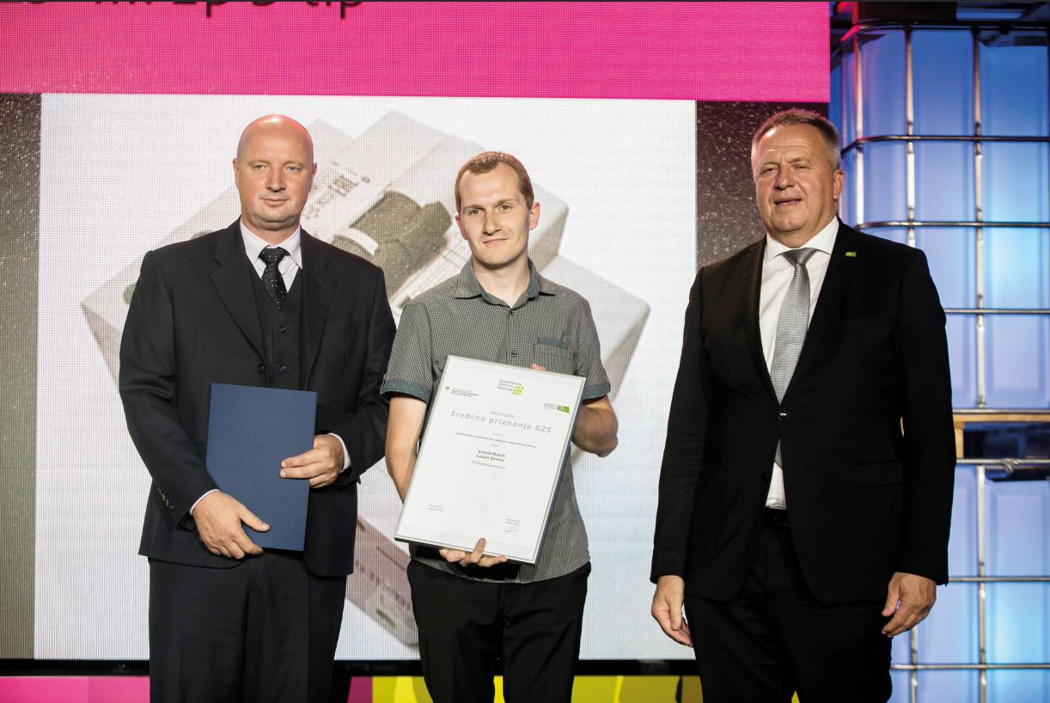
Naša budućnost se gradi na stručnjacima koji nadograđuju iskustvo prvih generacija svojim inovacijama i nedavnim novim saznanjima iz domena elektrotehnike
Istraživanje i razvoj
Zaposleni ETI-ja aktivno učestvuju u kreiranju bezbednosnih standarda u oblasti elektrotehničkih proizvoda kao članovi, pa čak i kao predsedavajući IEC odbora.
31 registrovanih patenata za razne proizvode
17 različitih brendova

Slide 14
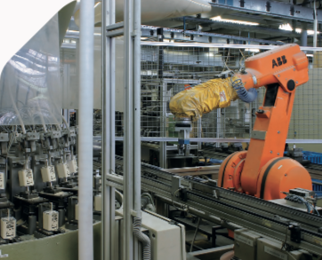
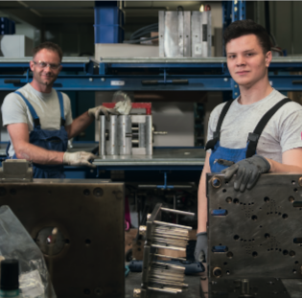
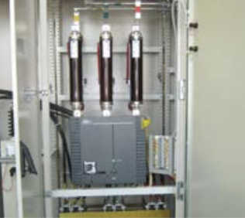
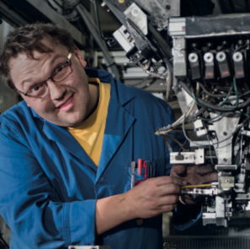
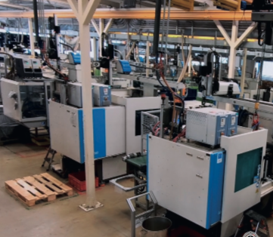
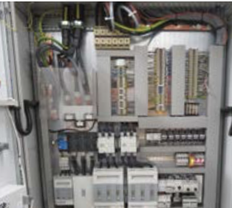
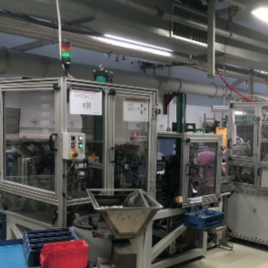
70-80%
Investicija se odnose na tehnološku opremu
Fleksibilnost proizvodnje
Pouzdan i fleksibilan partner koji brzo reaguje na nove zahteve i može ponuditi značajne proizvođačke kapacitete
Notes:
WE RESPOND swiftly to the needs of the market. We follow global trends in engineering and introduce the relevant ones into our production processes. We are constantly searching for solutions for more efficient and optimised production. As a medium- sized company, we are far more flexible in making customer requested adjustments than large rigid systems, yet we can still provide considerable production capacities.
High level of production automation, in-house components’ production, and our own know how in construction and assembly of production tools and assembly lines enable us to promptly respond to customer needs and various market situations. We operate in accordance with high-quality standards and are a trusted manufacturer.

Slide 15
In-house
Izrada najvažnijih komponenti
Mi smo stručnjaci za tehničku keramiku i plastične delove za elektrotehničku i automobilsku industriju.
Sopstvena izrada
Alata i montažnih linija za proizvodnju naših proizvoda.
Notes:
WE RESPOND swiftly to the needs of the market. We follow global trends in engineering and introduce the relevant ones into our production processes. We are constantly searching for solutions for more efficient and optimised production. As a medium- sized company, we are far more flexible in making customer requested adjustments than large rigid systems, yet we can still provide considerable production capacities.
High level of production automation, in-house components’ production, and our own know how in construction and assembly of production tools and assembly lines enable us to promptly respond to customer needs and various market situations. We operate in accordance with high-quality standards and are a trusted manufacturer.

Slide 16
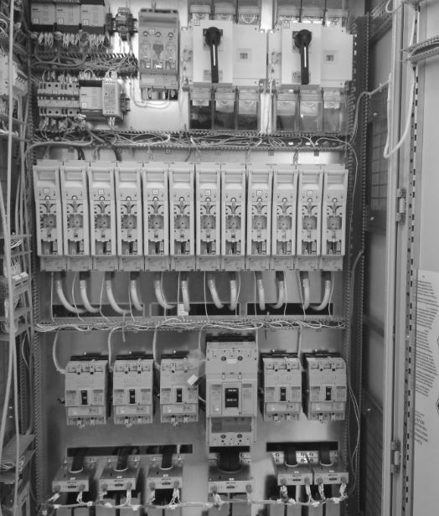
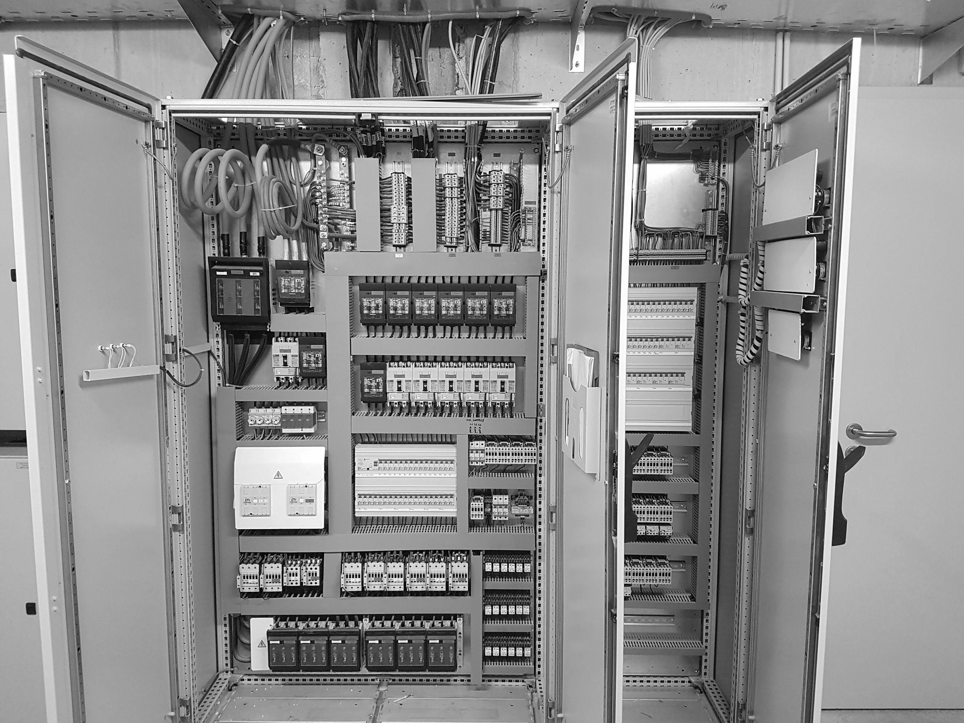
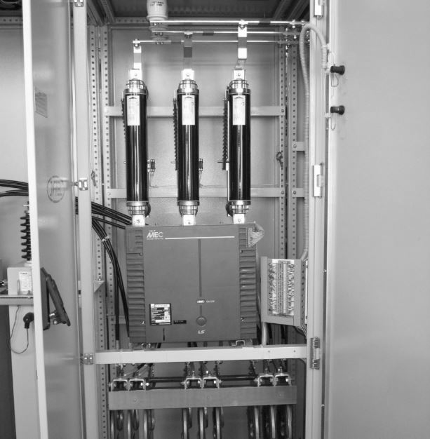
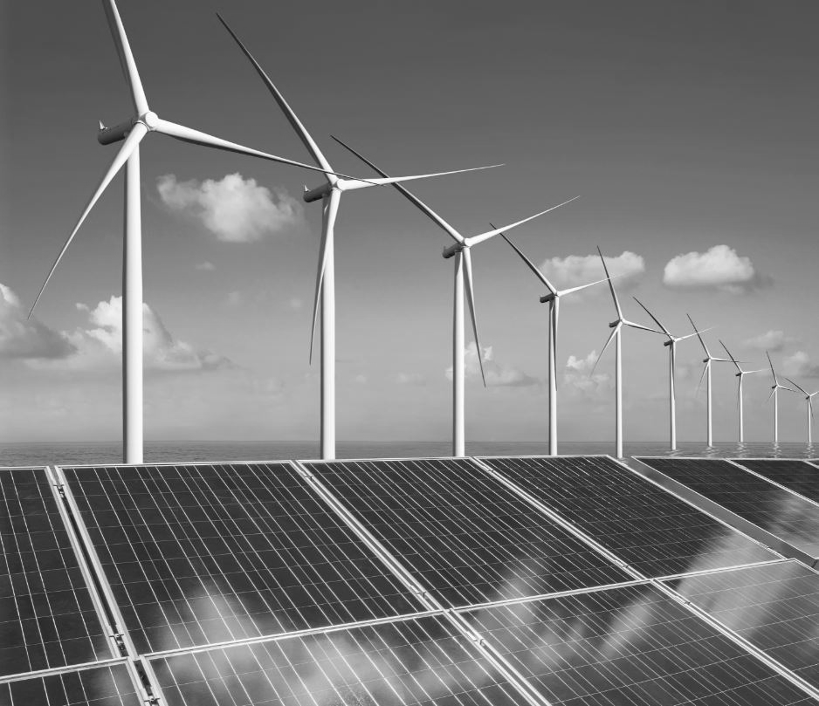
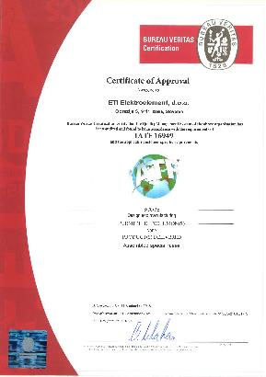
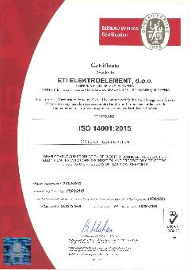
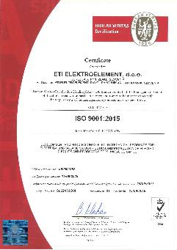
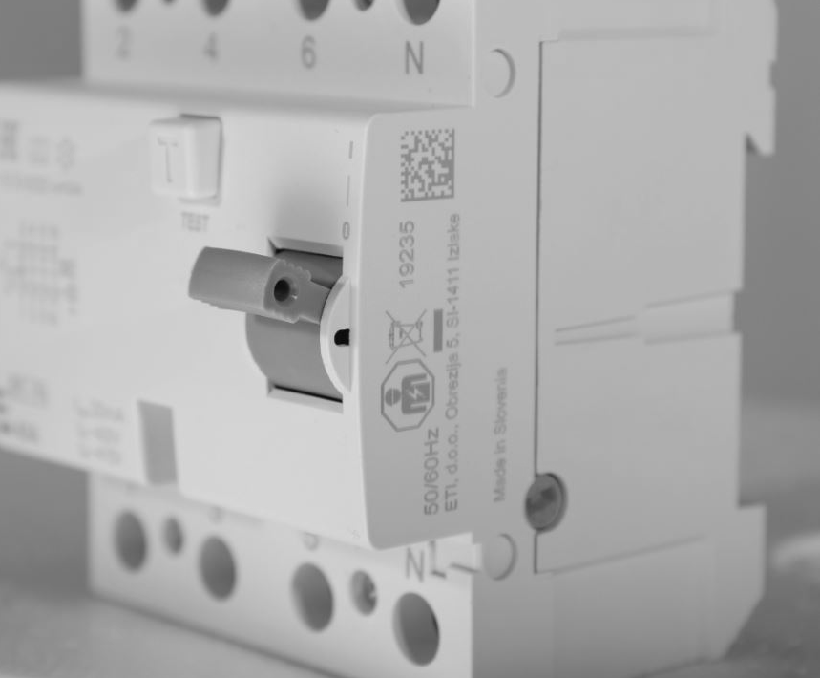
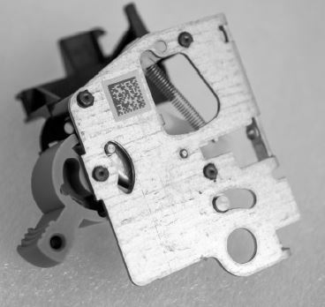
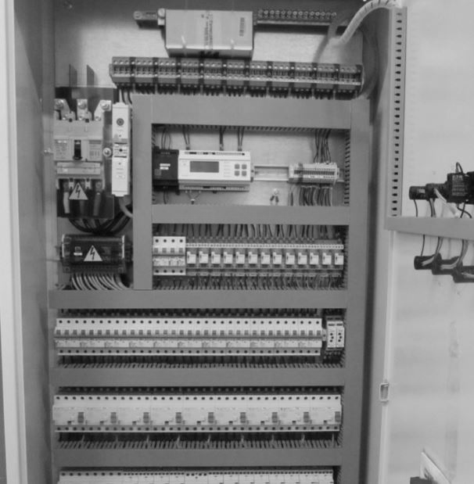
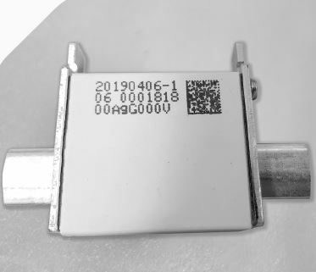
Dokazivanje sigurnosti
ETI proizvodi su u skaldu sa svim postojećim međunarodnim standardima kvaliteta.
Notes:
We make sure our customers feel safe. The electrical engineering industry is very conservative, so trust and reliability are two important components. With tradition and know-how we accumulated throughout the years, as well as the people who are the driving force of our company, the upcoming challenges represent the steps on our way to the top.
ETI provides automated 100% control of all key parameters of each product during production, the measurements are recorded in the form of a QR code printed on the component and the product.

Slide 17
Odličan odnos cene i kvaliteta
Perfomanse i vrednost
Razvijanje proizvoda koji zadovoljavaju potrebe tržišta i kreiraju nove trendove
Notes:
Our present and future ARE based on a high-quality offer of a full range of products in the field of electrical protection and control. Their competitiveness is achieved through the development of new product features and increasing production automation and optimisation. Our products (fuses, MCBs, MCCBs, and ACBs) cover the range from 0.5 A to 6300 A and we can provide individual products and product lines or complete, integral solutions for control and protection of electrical installations. The high quality and extensive range of our offer is the result of the requirements and expectations of our business partners, extensive market analysis and timely responses to market needs and potentials.

Slide 18
Residential and commercial Buildings
Utilities (Distribution of electric energy for low and medium voltage)
Power electronics, semiconductors and special purpose applications
Industrial installations
Primena naših proizvoda
MCB, RCCB,
RCBO, LV fuse
systems
System integration MCCB,
ACB,
LV fuse systems
NH gPV, DC Battery fuses, MV fuses
UQ fuses, SRF,
DC
Notes:
^{Reference}

Slide 19
Inteligentan
Učinkovit
pouzdan
Integralna rešenja
Integralna rešenja koja zadovojavaju širok spektar svrha, funkcionalnosti i očekivanja
Integralna rešenja za zaštitu stambenih i industrijskih instalacija (korekcija faktora snage, automatski prenos itd)
Notes:
^{Produktni rang template}

Slide 20
Reference
Notes:
^{Reference}

Slide 21
Orijentacija prema kupcu
Softverski alati za dizajnere, tehničko savetovanje, rešavanje specifičnih problema, digitalizovane baze podataka i brzi odgovor na potencijalne žalbe.
Notes:
On our website you will find various software tools for electrical designers, which make their work easier and at the same time enable them to make better informed and technically advanced choices for their customers.
Safety in the form of pre- and after-sales support; we offer software tools for designers, technical consulting, solving specific problems, digitalised product databases and quick response to potential complaints.

Slide 22
Odgovornost i partnerstvo
Naš pravac u prošlosti, sadašnjosti i budućnosti
Notes:
WE DELIVER
what we promise. Trust does not come with the signing of a contract, but with the relationship. We are proud of the above-average company growth, which is the result of meeting our obligations to all our partners.
Personal responsibility is reflected in the responsibility to our customers, employees, partners and the environment. This attitude has enabled us to build an internationally competitive, development-oriented and stable business group that successfully responds to market pressures and competition.
Our employees are a key factor in the company’s success. Our knowledge, rich work experience, high level of affiliation and motivation represent significant capital for a company that we develop and protect.

Slide 23
ETI u brojkama
Neto poslovni prihodi
Prihodi po tržištima
Konstantan rast
Slovenija
Balkan
Nemačka
Istočna Evropa
Ostatak Zapadne Evrope
Ostatak sveta
Konsolidovana prodaja 2018: 124 miliona EUR

Slide 24
17
4
% Prihoda uloženog u istraživanje, razvoj i tehnologiju
^{Konstantan}
^{RAST}
^{brendova}
1900
31
9
^{% Prihoda od novih proizvoda}
^{Preko}
^{Zaposlenih širom Evrope}
^{Patent proizvoda}

Slide 25
Prema
Zelenoj Održivoj Obnovljivoj
Budućnosti
ETI GREEN PROTECT za sva tržišta, od stambenih do industrijskih rešenja do 1500V DC
Specijalni osigurači za zaštitu Sistema za skladištenje i e-mobilnost
Energetsja efikasnost u pogledu smanjenja disipacije energije kao osnova smanjenja potrošnje
Pametne instalacije
Podržavamo naše klijente
Pravi odgovori
Buduće potrebe
Notes:
WE DELIVER
what we promise. Trust does not come with the signing of a contract, but with the relationship. We are proud of the above-average company growth, which is the result of meeting our obligations to all our partners.
Personal responsibility is reflected in the responsibility to our customers, employees, partners and the environment. This attitude has enabled us to build an internationally competitive, development-oriented and stable business group that successfully responds to market pressures and competition.
Our employees are a key factor in the company’s success. Our knowledge, rich work experience, high level of affiliation and motivation represent significant capital for a company that we develop and protect.

Slide 26
Budućnost je zelena
Pioniri u oblasti zaštite fotonaponskih sistema
Zaštita baterija za skladištenje
Zaštita PV pretvarača
E-mobility
Zašita za vetrogeneratore
Notes:
WE DELIVER
what we promise. Trust does not come with the signing of a contract, but with the relationship. We are proud of the above-average company growth, which is the result of meeting our obligations to all our partners.
Personal responsibility is reflected in the responsibility to our customers, employees, partners and the environment. This attitude has enabled us to build an internationally competitive, development-oriented and stable business group that successfully responds to market pressures and competition.
Our employees are a key factor in the company’s success. Our knowledge, rich work experience, high level of affiliation and motivation represent significant capital for a company that we develop and protect.

Slide 27
Pametne instalacije
Energetska efinasnost
Smanjenje gubitaka
Mala disipacija energije naših osigurača i prekidača, omogućava značajno smanjenje prostora i potrošnje energije
Nova generacija gG osigurača
EFI-P
Kontrola kao osnova efikasnosti
Zaštitni uređaji sa funkcijom merenja
Metering fuses
RCBO sa merenjem potrošnje

Slide 28
ETI B doo Beograd
Zvečanska 56/17
www.etib.rs
+381 11 3691 092
+381 65 3691 092
E-mail: etib@etib.rs
Mi mislimo na vašu sigurnost, tako da vi ne morate
Notes:
Thank you for your time, I hope that you get the point the is not only about products, but is about our people, values, brand manifesto which bring to safety of our products and high customer satisfaction.
I would be pleased to answer all your questions? So do not hesitate to to contact me now or via e-mail:

